Slide 1

Authored by Dan Burton
August 2018
First and Last Touch
Attribution with
CoolTShirts.com
Learn SQL from Scratch

Slide 2
Table of Contents
1. Get familiar with the company.
How many campaigns and sources does CoolTShirts use and how are they related? Be sure to explain the difference between utm_campaign and utm_source.
What pages are on their website?
2. What is the user journey?
How many first touches is each campaign responsible for?
How many last touches is each campaign responsible for?
How many visitors make a purchase?
How many last touches on the purchase page is each campaign responsible for?
What is the typical user journey?
3. Optimize the campaign budget.
CoolTShirts can re-invest in 5 campaigns. Which should they pick and why?

Slide 3
Get Familiar With
The Company

Slide 4
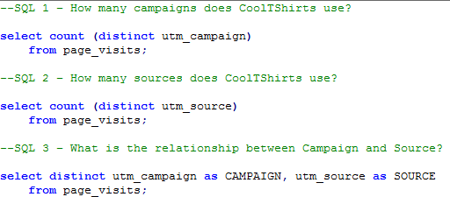
1.1 How many campaigns and sources does CoolTShirts use and how are they related?
I can evidence the number of campaigns that CoolTShirts use by undertaking a distinct count of the utm_campaign field (SQL 1/fig1)
fig1
I can repeat the query but amend the utm_campaign to utm_source to determine the number of sources (SQL 2/fig1)
CAMPAIGNS | SOURCES
8 | 6
CAMPAIGN | SOURCE
getting-to-know-cool-tshirts | nytimes
weekly-newsletter | email
ten-crazy-cool-tshirts-facts | buzzfeed
retargetting-campaign | email
retargetting-ad | facebook
interview-with-cool-tshirts-founder | medium
paid-search | google
cool-tshirts-search | google
fig2
To evidence the relationship between the two I can display the sources per campaign. This will show how the campaign reaches the consumer. (SQL 3/fig2)

Slide 5
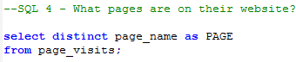
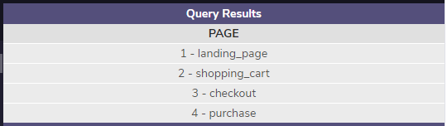

1.2 Which pages are on their website?
To identify which pages are present on their website, I can use a distinct statement on the field page_name. I can add an alias to make the table name more relevant.

Slide 6
What is the
user journey?

Slide 7
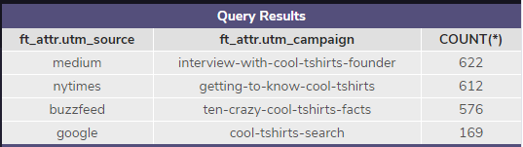
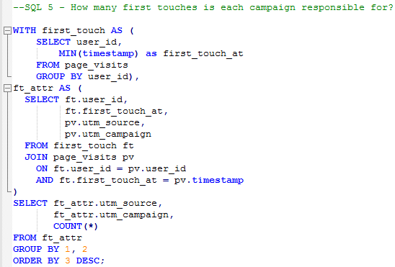

2.1 How many first touches is each campaign responsible for?
To display the number of first touch page visits for each campaign, and their source, I can create two temporary tables and then count the source and the campaign from the ft_attr (first touch) table. By selecting the MIN(imum) timestamp the query will display the earliest time the page was visited. We can identify this as the first touch. It is important to group these so that it is clear to read. In this instance the campaign that generated the highest number of page visits came from an interview with the CoolTShirts founder in Medium magazine.

Slide 8
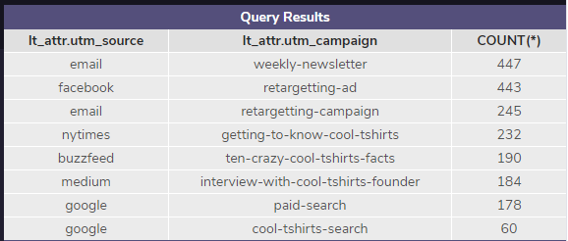
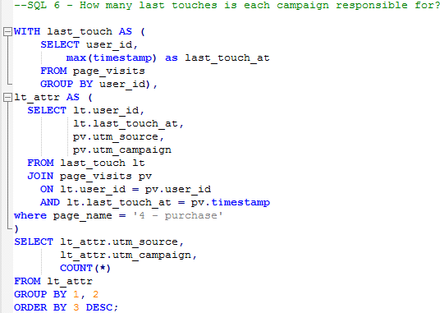

2.2 How many last touches is each campaign responsible for?
We can make some tweaks to the code to identify the last touch. In this instance we would want to display the MAX(imum) timestamp of a page visit. This would be classed as the last touch before the user exited the website. We can determine from this that the most engagement is from the emailed weekly newsletter. We can make a presumption that users who sign up for a newsletter are the most actively engaged customer segment.

Slide 9
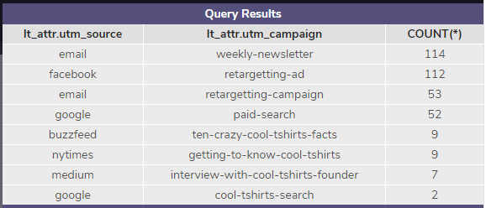
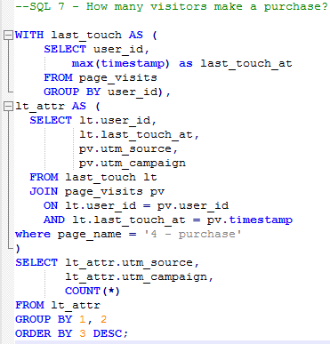

2.3 How many visitors go on to make a purchase?
With a further tweak to the last touch code, we can determine how many visitors go on to make a purchase, (358). We can also identify the campaign and the source that drives that purchase. I have added in a WHERE statement to limit the last touch results to the ‘Purchase’ page.

Slide 10
2.4 How many visitors go on to make a purchase?
With a further tweak to the last touch code, we can determine how many visitors go on to make a purchase, (358). We can also identify the campaign and the source that drives that purchase. I have added in a WHERE statement to limit the last touch results to the ‘Purchase’ page.

Slide 11
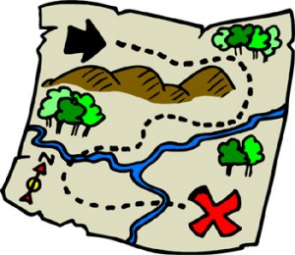
2.5 What is the typical user journey?
Of the four campaigns that generated engagement with the CoolTShirts website, three of these were magazine style articles. These articles generated 92% of the first touch traffic to the website. However, only 1.26% of these visits actually went on to make a purchase following this visit.
The most actively engaged customers are those who either have signed up for the weekly newsletter via email or have received a retargeting advert via either Facebook or email. 14% of the users who have received the newsletter or retargeted advert go on to make a purchase.

Slide 12
Optimize the
Campaign budget.

Slide 13

3.1 CoolTShirts can re-invest in 5 campaigns. Which should they pick and why?
It is apparent that the most successful campaigns to generate page views are the magazine style articles for modern outfits such as Buzzfeed and more traditional websites such as the New York Times and Medium. I would make a recommendation that these campaigns continue. However, there needs to be some consideration on how to convert these initial page views into paying customers.
In addition to the media based campaigns, the most successful campaigns to generate paying custom is the retargeting adverts via Facebook and the weekly newsletter. I would recommend continuing with both of these. Facebook works well for those customers who may not actively engage via signing up for the newsletter, but may make a purchase through the persistence of the retargeting advert.

